Slide 1
CarcinoCheck

Slide 2
Our Team
Team : Whitebeard Crew
Team Members :
Saswat Mishra
Kumar Abhishek
Rudra Prasad Dash
College : National Institute Of Technology, Rourkela

Slide 3
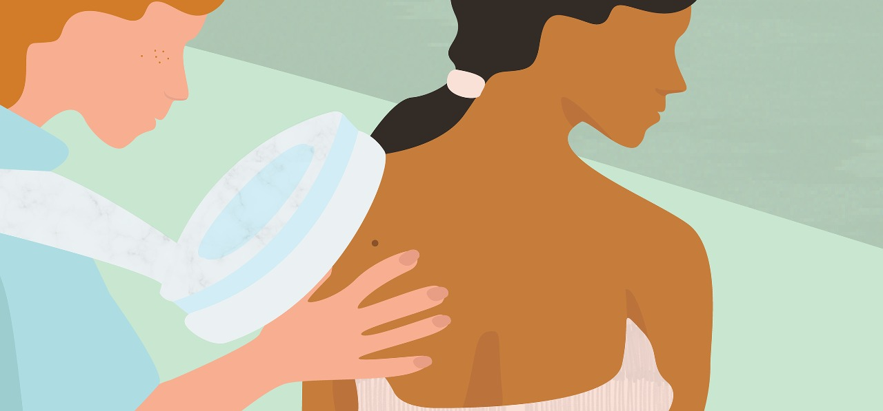
Are you worried about this patch?
Yes, Is there anyway I can perform self-diagnosis ?

Slide 4
Problem Overview
During the corona pandemic, people have to suffer as COVID testing is first required before performing any other medical diagnosis.
This leads to a delay in diagnosis which causes further delay in treatments.
The side effects include constant worry and anxiousness among individuals.
Diagnosis delay leads to unnecessary frequent visits to hospitals as well.
Problem in decision making of dermatologists.

Slide 5

Our Solution
Reduces diagnosis delay.
Predicts type of skin cancer.
Provides questionnaire based evaluation.
Access dermatologists and hospitals in nearby location.
Reduces frequent visit to hospital during corona pandemic.

Slide 6



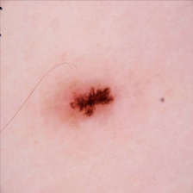


WORKFLOW
Website
User
Report
Questionnaire
Image
REST API

Slide 7
Technology Used
Programming Language Used
JavaScript
Python
Model Development
Scikit-Learn
TensorFlow 2.0
REST API development
Flask
Website Development
Node.js
Bootstrap
APIs Used
Geo-location finder
Version Control
Git

Slide 8
Future Aspects
A premium feature including consultation with doctors through a text based interface on our website.
An app including all the features on the website.
An internal team of dermatologists who will be available for online consultation for places with no nearby skin care hospitals.

Slide 9
Competitors:
SkinVision (Amsterdam )
Skin Analytics (U.K )
SkinIO (Chicago)
FirstCheck (New Zealand)
CureSkin (India)

Slide 10
Monetization
In App ad revenue generation from contextual advertising from skin care hospitals and skin related medical products.
Premium version of app will enable users to remove ads.
Premium plan for direct online consultation with skin cancer specialists from a panel of specialists.

Slide 11
Thank You

